Slide 1
Towards Evidence Extraction: Analysis of Scientific Figures from Studies of Molecular Interactions
Gully Burns¹, Xiangyang Shi¹, Yue Wu¹, Huaigu Cao¹, Prem Natarajan¹
¹ Intelligent Systems Division, USC’s Information Sciences Institute
https://sciknowengine.github.io/

Slide 2

Molecular Biology is both complex and beautiful
Inner Life of the Cell (https://youtu.be/wJyUtbn0O5Y)
Notes:
3:48

Slide 3
Molecular Interactions

Slide 4

https://www.ebi.ac.uk/intact/
European Bioinformatics Institute @ Cambridge, England
A large-scale, high-quality manually curated database
Content
20,065 curated papers in total
2,254 open access papers
Describes molecular interactions + detection methods linked to specific subfigures (e.g., Fig. 1b, 3d, etc.)

Slide 5
Scientific Cycles of Investigation

Slide 6
Can we automatically classify types of scientific evidence?
Can we automatically classify types of scientific evidence figures from articles?

Slide 7
Pipeline

Slide 8
1. Extracting Whole Figures
https://github.com/BMKEG/lapdftext
Build a spatial index of tightly packed text blocks
Locate Caption Text blocks
Regular Expression: ^Fig(ure|ure.|.)[0,1]\s*(\d+)
Find areas of low word density above, below and to the side of the caption
Remove caption text
Crop low word density space + caption region

Slide 9
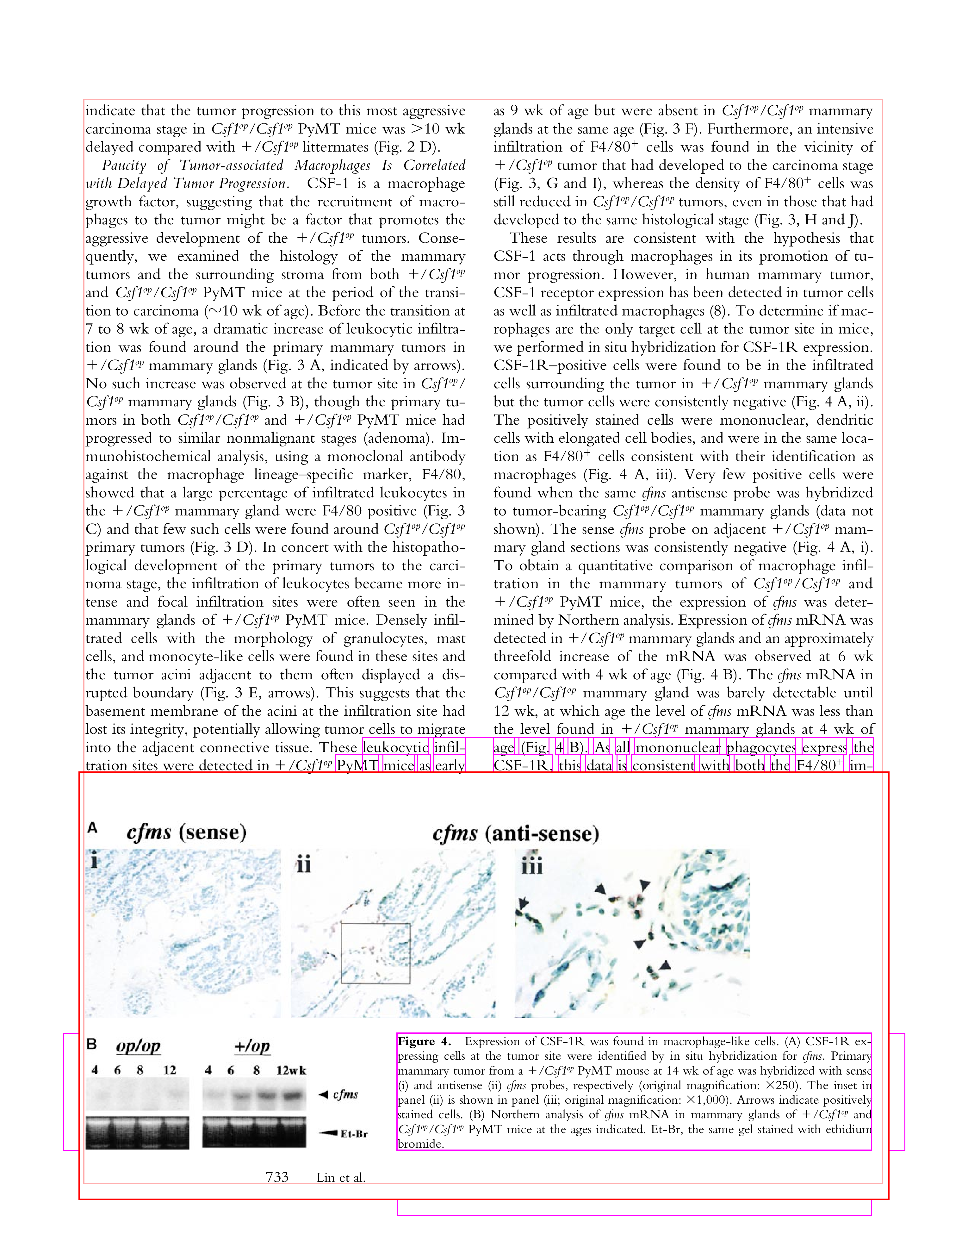
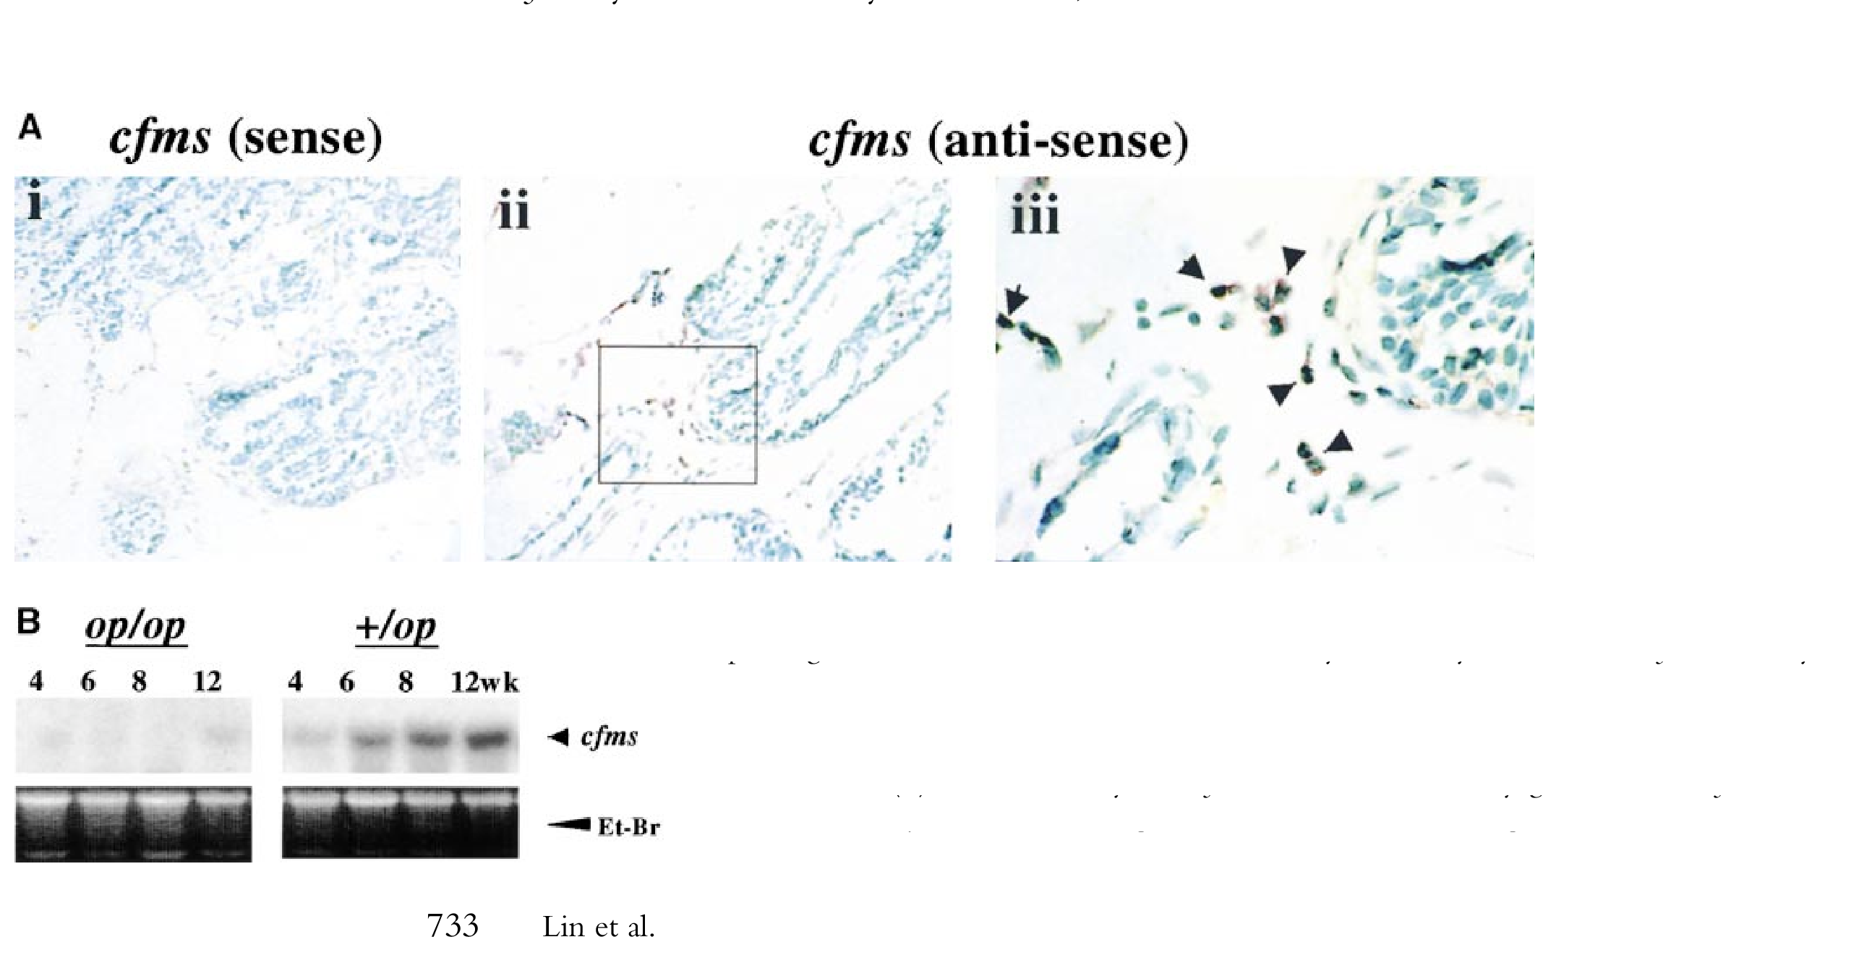

Slide 10
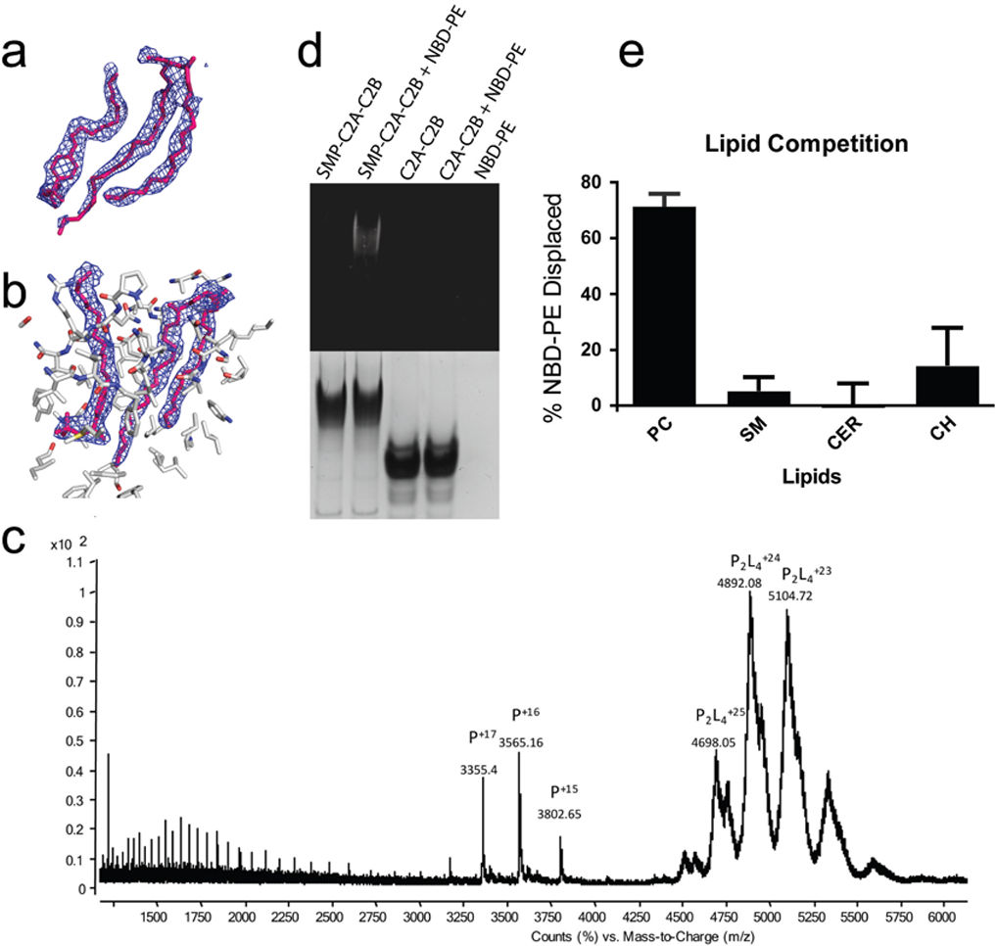
2. Delineating Subfigures

Slide 11
Heuristic Baseline Method
Detect letters that denote each subfigure (‘A’, ‘B’, etc.) using connected component analysis.
Use a greedy tiling mechanism that places the letter in the top left corner of panels to construct a rectangular layout for each panel in a figure.
A figure is cut into multiple sub-panels by straight lines that go along the top or left side of each detected letter.

Slide 12
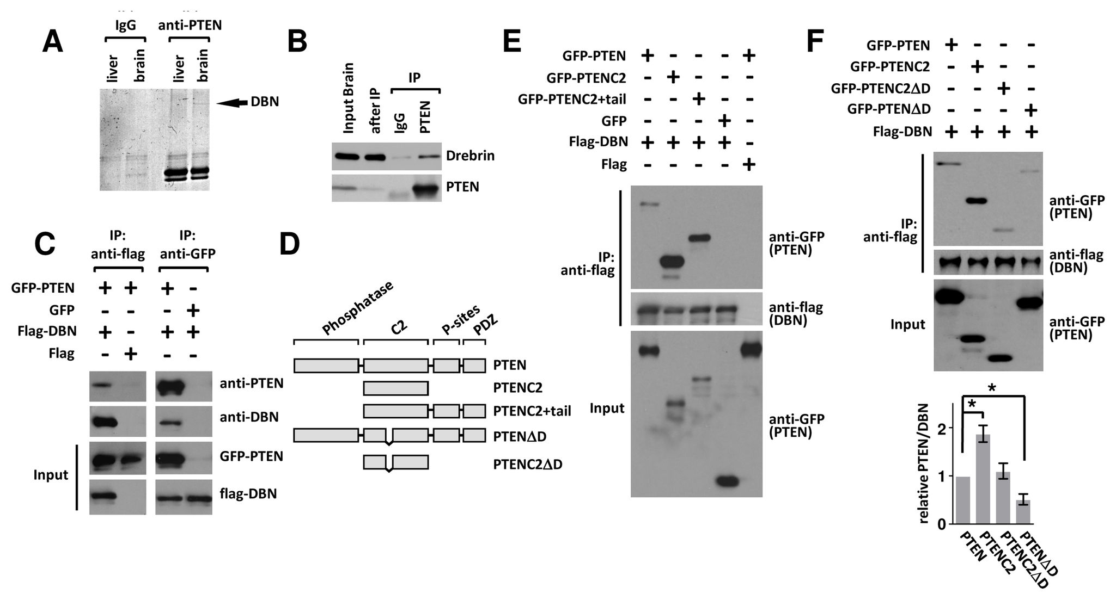
Baseline Example

Slide 13
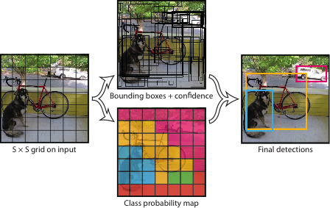
‘You Only Look Once: Unified, Real-Time Object Detection
Redmon et al. (2015) CoRR abs/1506.02640
Used for Compound Figure Separation by Tsutsui & Crandall, (2017), ICDAR

Slide 14
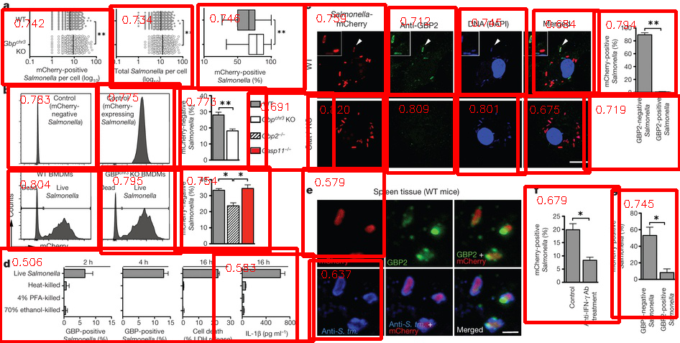
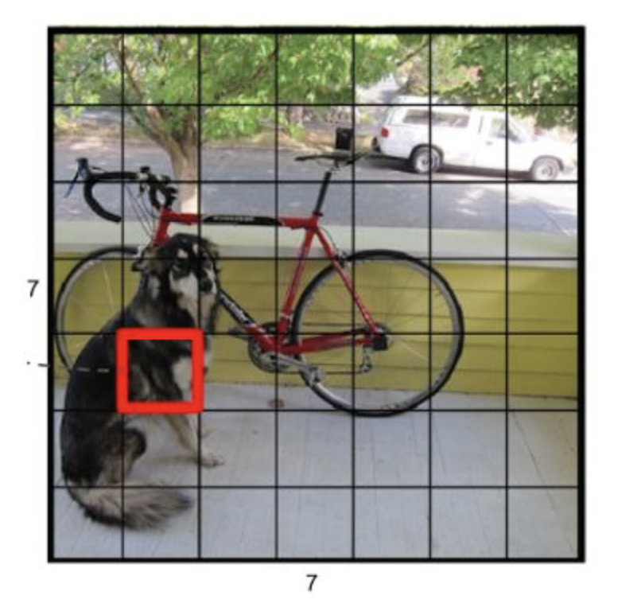
YOLO is biased to fine-grained delineation
YOLO
Grid
In standard YOLO, the hyper-parameter: # of Grids is set as 13*13,
Its too many for academic images, the network always favor tiny subfigures. (bias)
Different layout is sensible to Grid #.
We apply a model based on applying multiple sets of grids.
Notes:
Yolo has an implicit layout setting - 13x13, of course we can change it, but again this network will be inappropriate for input images of different layouts
Yolo is biased to small / square like figures
…

Slide 15
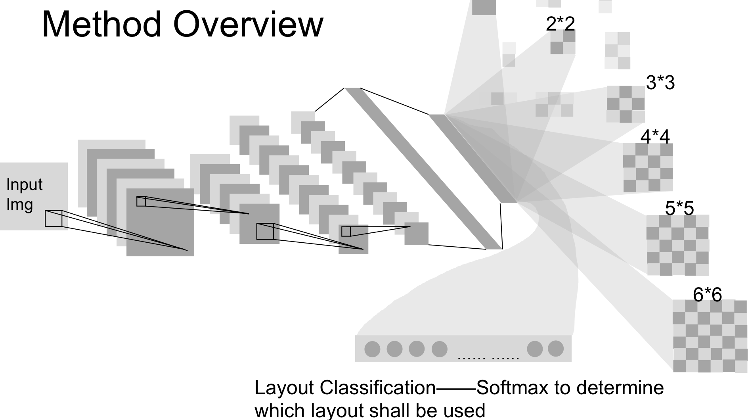
Layout Aware YOLO

Slide 16
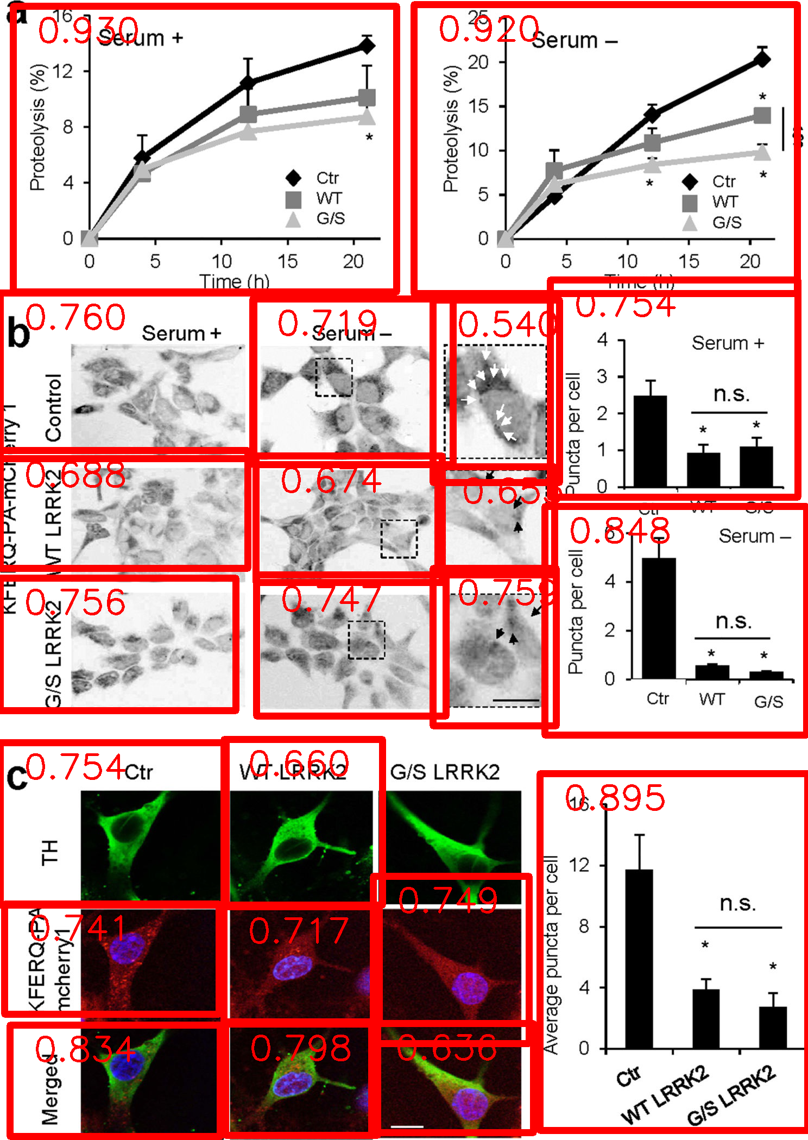
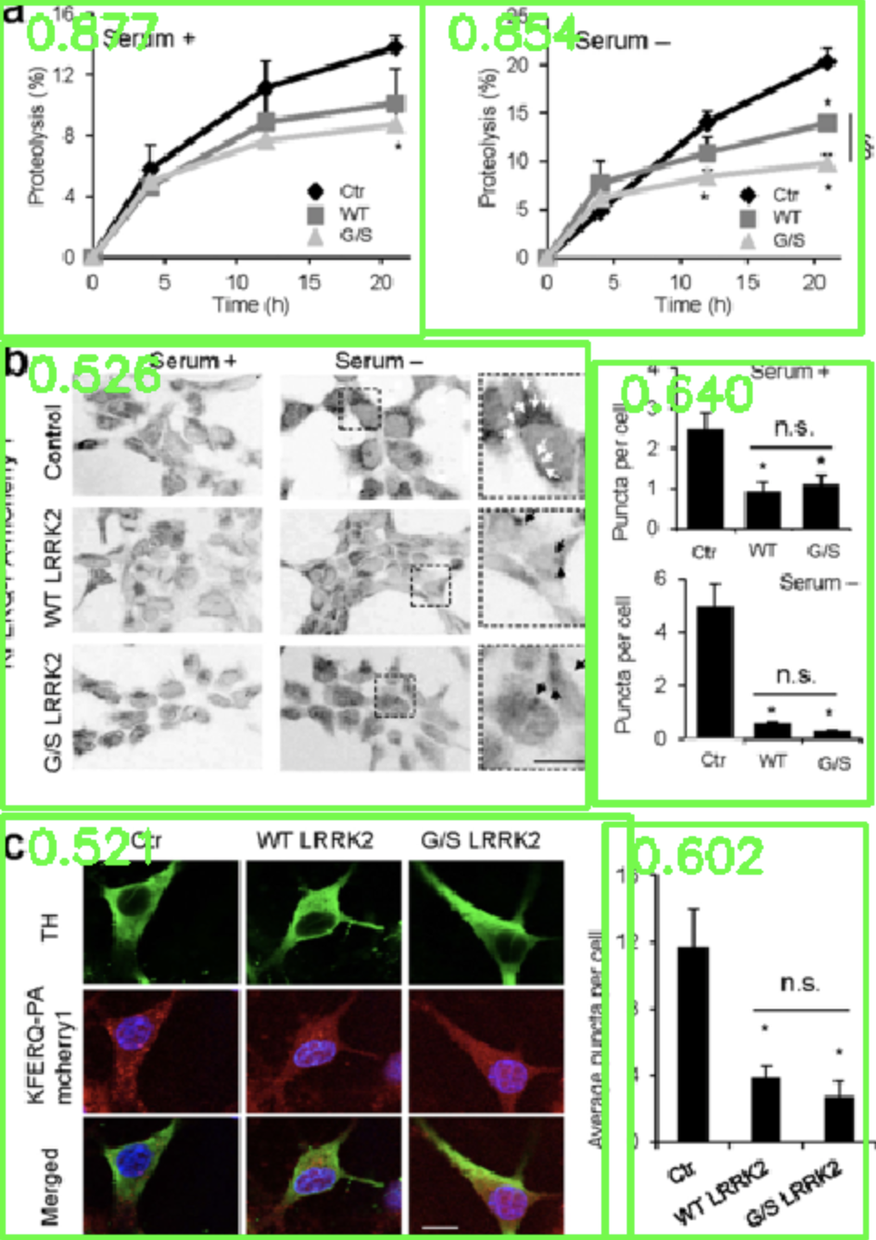

Slide 17
Preliminary Analysis of data from INTACT 2017
Method | Accuracy
Heuristic Greedy Cut | 0.78
YOLO | 0.76
Layout Aware YOLO | 0.84

Slide 18
3a. Classifying Subfigures
LeNet image classification algorithm
Manually annotated images from INTACT database

Slide 19
3b. Classifying Evidence Text
Train simple CNN + LSTM classifiers predict detection method codes from INTACT ‘evidence fragments’ and sub-captions
3,366 open access INTACT records

Slide 20
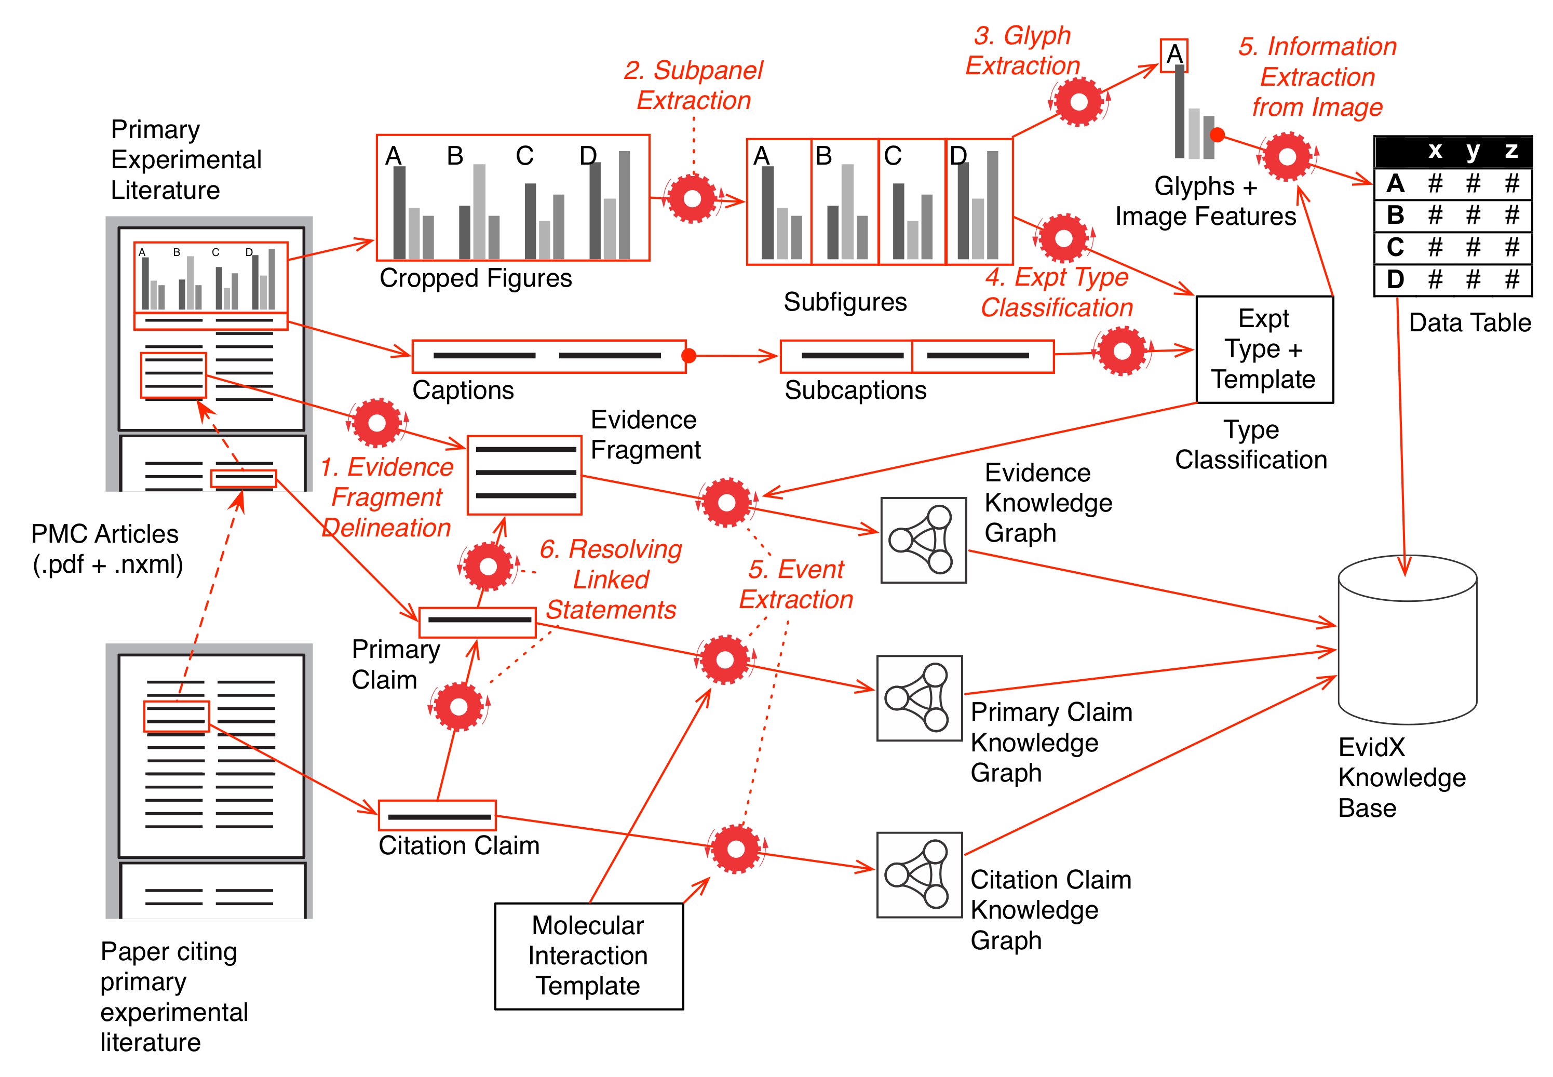

Slide 21
‘Towards’ Evidence Extraction Templates

Slide 22
Linked Data as a Research Object http://purl.org/ske/ro/semsci18
Tools:
https://github.com/SciKnowEngine/evidX/releases/tag/v0.1.0 TensorFlow Classifiers used to classify text of subfigure captions by method type.
https://github.com/SciKnowEngine/UimaBioC Text preprocessing pipelines
https://github.com/SciKnowEngine/lapdftext PDF image and text extraction tools
Data
https://doi.org/10.5281/zenodo.1315036 ‘Molecular Biology Open Access Pubmed Word and Sentence Representations’
https://doi.org/10.5281/zenodo.13150211 ‘Method Classification of Open Access INTACT Molecular Interaction data.’
https://doi.org/10.5281/zenodo.1319198 ‘Partitioned Image Data for Machine Learning Analysis of Molecular Biology Figures’

Slide 23
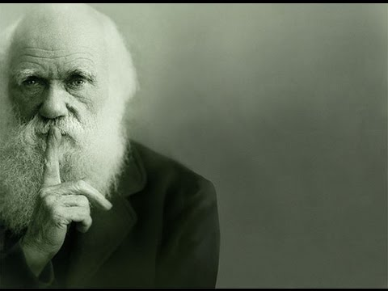
Acknowledgements
Nanjun Peng Xiangci Li
Pradeep Dasigi
Ed Hovy
Anita De Waard
NIH 5R01LM012592-02
DARPA Big Mechanism
under ARO contract
W911NF-14-1-0436

Slide 24
